Slide 1
How to use syrmDesign.m and SyR-e
Nov 6, 2015
gianmario.pellegrino@polito.it

Slide 2
Introduction
syrmDesign.m is a Matlab script purposely written to the benefit of the WEMPEC Boot Camp attendees, to help with all the mathematics developed for preliminary design of one SyR motor. This script is also useful to familiarize with SyR-e and for running it for the first time.
With reference to the 3-step design procedure of PM-assisted SyR machines:
1) design of the baseline SyR machine
2) design of virtual PM contribution Br
3) turn virtual PM into a commercial PM grade
syrmDesign.m job covers a large part of point 1), namely the (x,b) parametric analysis of torque and PF of the baseline SyRM.
Eventually, the script produces a FEMM machine model compatible with SyR-e for further FEA evaluation and subsequent design of the PM-assistance

Slide 3
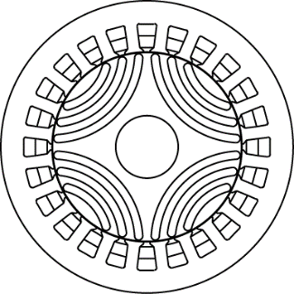
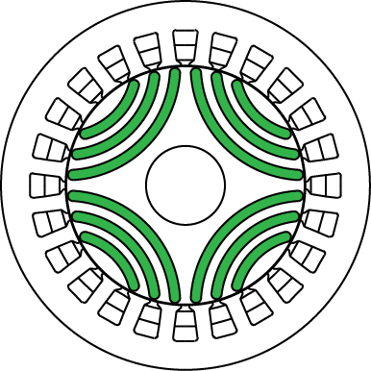
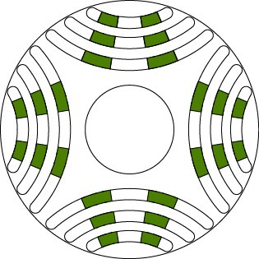
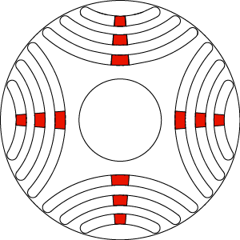
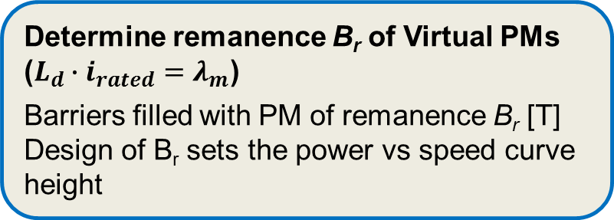
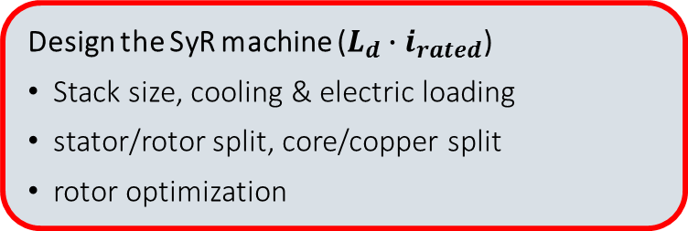
Background: 3-step Design Procedure
Step 1 design of baseline SyR machine
Design the SyR machine ($L_{d}∙i_{rated}$)
Stack size, cooling & electric loading
stator/rotor split, core/copper split
rotor optimization
Step 2 Design Br of equivalent PMs
(e.g. Br = 0.15 T)
Determine remanence B_{r} of Virtual PMs ($L_{d}∙i_{rated}=λ_{m}$)
Barriers filled with PM of remanence B_{r} [T] Design of B_{r} sets the power vs speed curve height
Step 3: Finalize design with real PMs
Finalize Real PMs (Ferrite or NdFeB)
Final PMs are calculated, according to the selected commercial material
Ferrite (Br ' = 0.4 T)
NdFeB (Br '' = 1.2 T)

Slide 4
Background: Design Flowchart
Torque target
Preliminaries
Define outer stack size (D,L) and thermal loading factor (k_{j} [W/m²])
Increase/ reduce stack size,
Improve cooling
Step 1
Design a SyRM capable of 75% - 80% of the target torque specification
n_{max} power target
Step 2
Start over
Design B_{r} (virtual PM) so to meet the characteristic current condition
Increase/decrease current and PMs
Torque and Power ok?
NO, by little
NO,
substantial
Step 3
YES
Translate B_{r} into a commercial PM (inverse proportion of PM volumes)
END

Slide 5
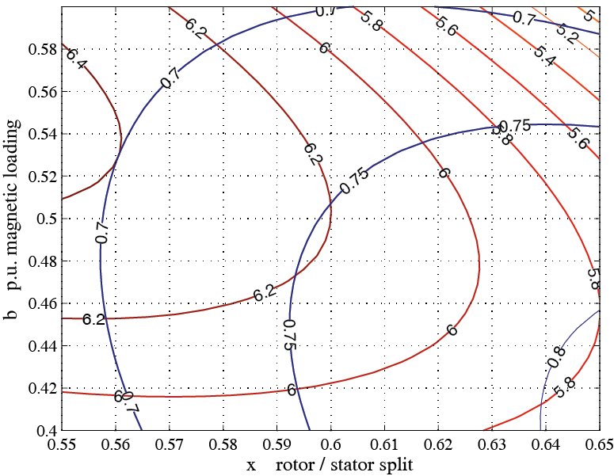
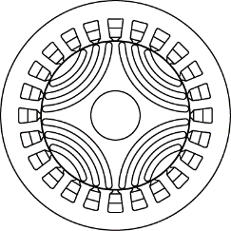

syrmDesign.m does the (x,b) Parametric Analysis
Design Specs:$p, B_{Fe}, k_{Cu}$ ..
Stack size and airgap: $D,L,g$
Thermal loading: $k_{j}$
Starting data are in demo Syr-e file BootCamp2015.mat
syrmDesign.m
Loads data file Torque(x,b) and PF(x,b) equations
Torque (red) and PF (blue) contours
PF
Selected design exported to SyR-e
b
x,b = 0.65, 0.5
Nm
x
x,b = 0.65, 0.5

Slide 6
syrmDesign runs SyR-e
After (x,b) parametric analysis, syrmDesign.m enters into SyR-e, and commands to build a new machine model, based on the main data from the demo (BootCamp2015.mat), but with the rotor and stator dimensions dictated by the selected values of b and x.
Such new model can be FEA evaluated in SyR-e and will be the foundation for design steps 2) and 3)

Slide 7

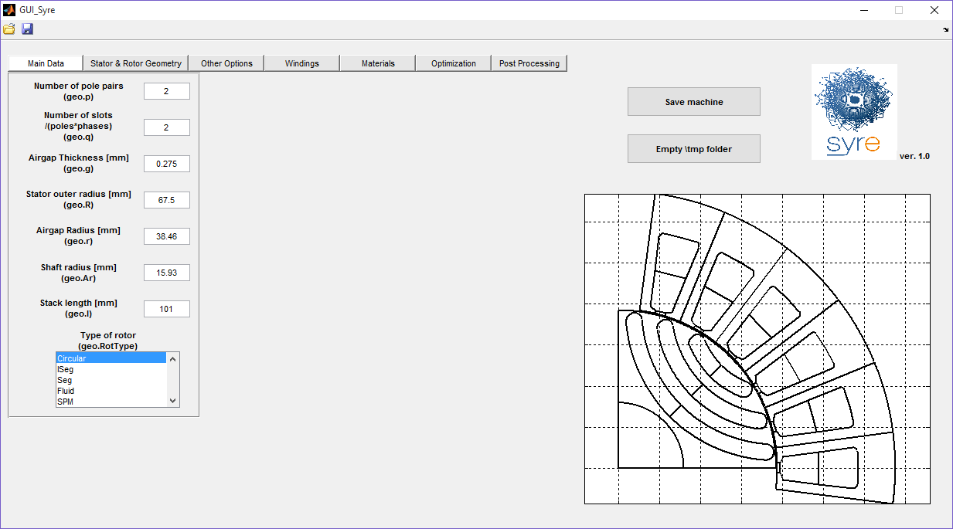
Background: SyR-e
SyR-e stands for Synchronous Reluctance – Evolution and is an open-source (*) Matlab/Octave code developed to design synchronous reluctance machines with finite element analysis and the aid of multi-objective optimization algorithms.
You have one version of SyR-e in this folder (syre20151106)
Updated version of SyR-e available online at
http://sourceforge.net/projects/syr-e/
It requires Matlab/Octave and FEMM softwares installed
(*) LICENSE: The C++ programs based on the original FEMM source code are licensed under the Aladdin Free Public License, as the original FEMM source is also provided under this license. The Matlab/Octave code is provided under the Apache Version 2.0 license. Further details and the texts of these licenses are provided with the source.

Slide 8
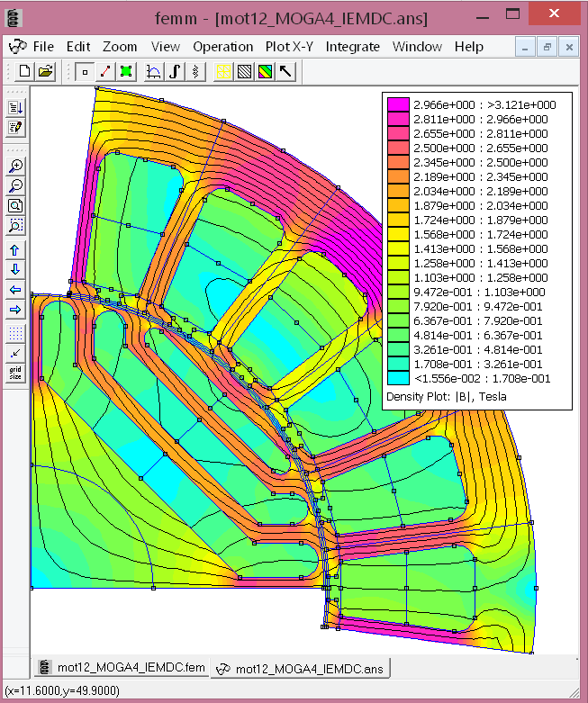
Install FEMM in C:\femm42
Finite Element Method Magnetics (FEMM)
www.femm.info
A Windows based, Finite Element solver for 2D and axisymmetric magnetic, electrostatic, heat flow, and current flow problems with graphical pre- and post-processors.
The FEMM 4.2 distribution includes scripting features for interaction with FEMM from Octave/Matlab, Scilab, and Mathematica.
Multiple threads of FEMM can be launched on the same machine, so to take advantage of multi-core processing (Matlab command matlabpool or parpool)

Slide 9
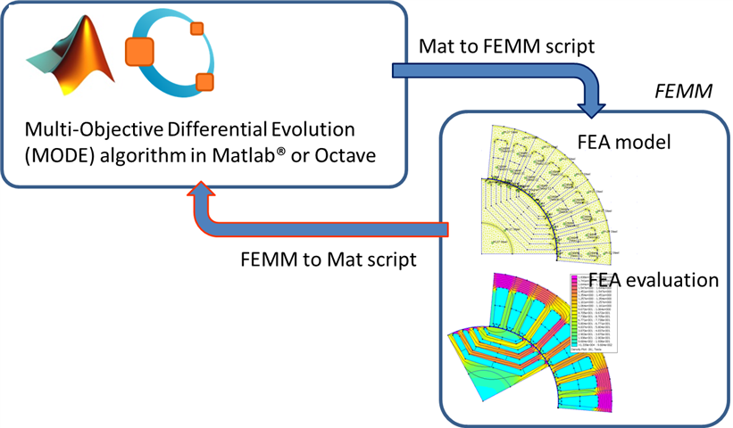

Data Flow of SyR-e
Data exchange is handled via Matlab scripts
Direct flowchart

Slide 10
Instructions for running syrmDesign.m

Slide 11
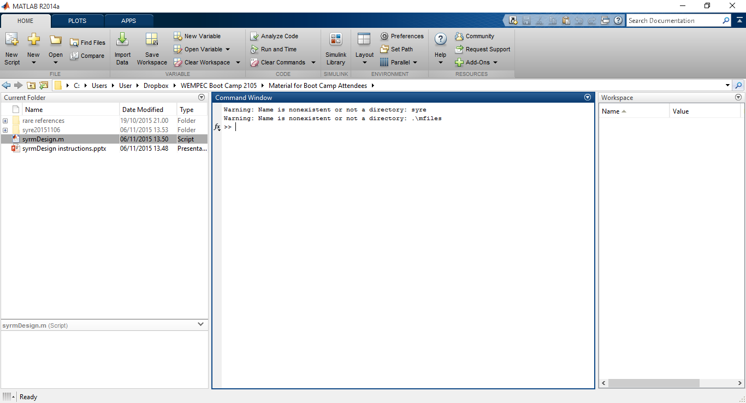
Open Matlab and run syrmDesign.m

Slide 12
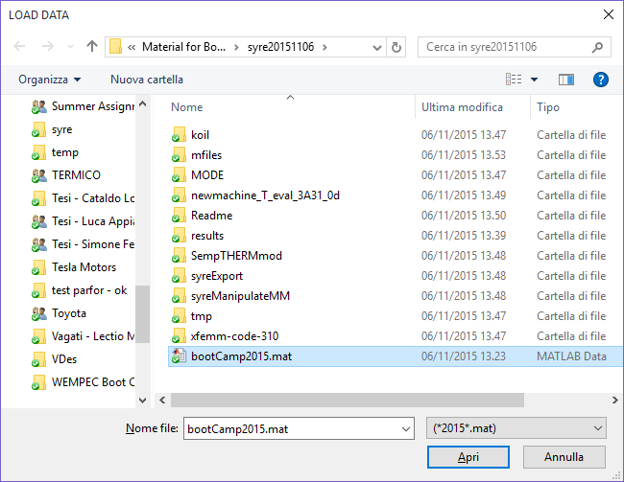
Select the demo model bootCamp2015.mat

Slide 13
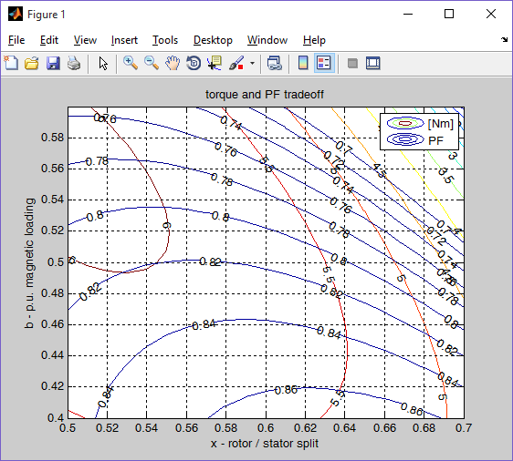
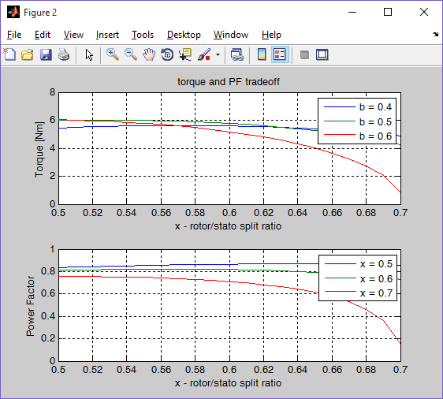
Two figures will pop up
Fig1: Torque and PF parametric analysis (x,b) of the SyRM
Fig2: same quantities, in one dimensional plots

Slide 14
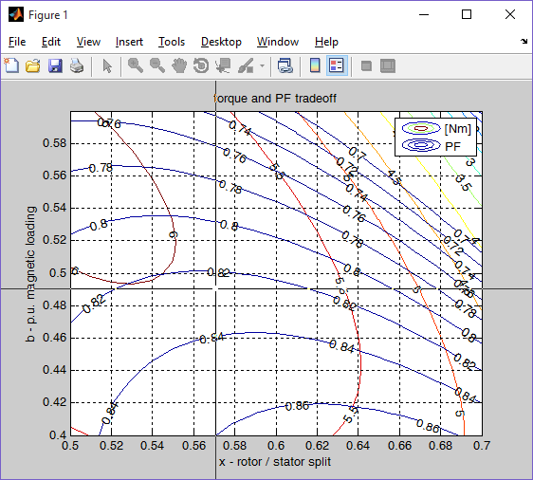
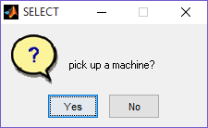
After you press any key
Matlab is currently paused.
After pressing any key you will be required to select a machine to be picked up from the (x,b) plane
Coordinates x = 0.57, b = 0.49 are selected in this example
A new syre model is created, and syre is launched straight away to visualize the new machine
New model is called bootCamp2015x057b049

Slide 15
Syre is automatically launched
Syre GUI pops up
After some iteration, the machine you will se in the plot window is the one you selected from the x,b chart
(x = 0.57, b = 0.49)

Slide 16
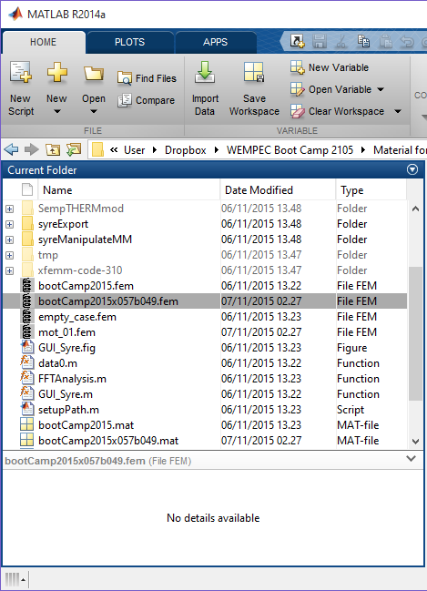
Machine data files
This new machine’s data are stored permanently in the new case file named
bootCamp2015x057b049.fem
bootCamp2015x057b049.mat
(two files per each machine), in the same folder of the original data file bootCamp2015.fem

Slide 17
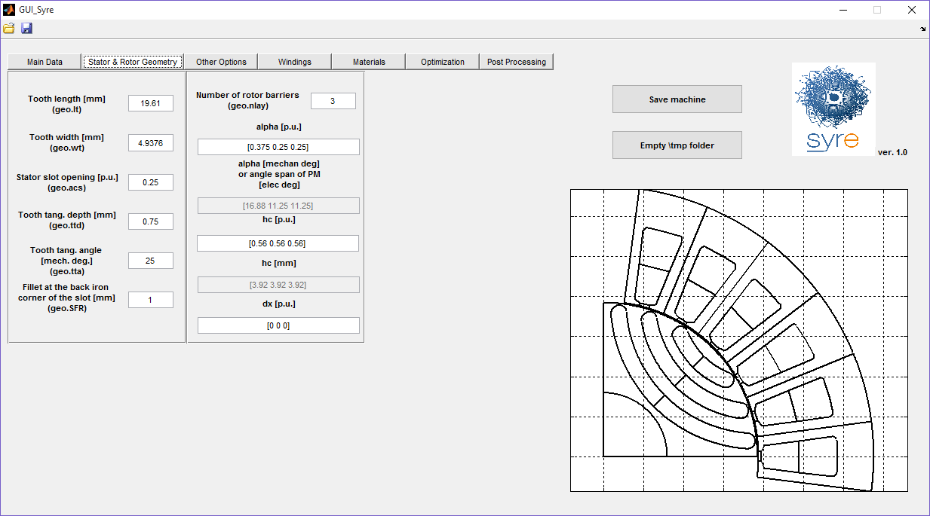
Design Parameters Across the Tabs of the GUI
Browsing the GUI, you can become aware of how the machine’s parameters are organized (dimensions, geometry, winding scheme etc .. ) and what are their values for this design example
You can also load other machine examples that you have (bootCamp2015.fem and mot_01.fem) and do the same
Data of bootCamp2015.fem and children bootCamp2015x057b049.fem are very similar: the ones affected by x and b are rotor radius r, tooth length lt, tooth width wt, rated current i0

Slide 18
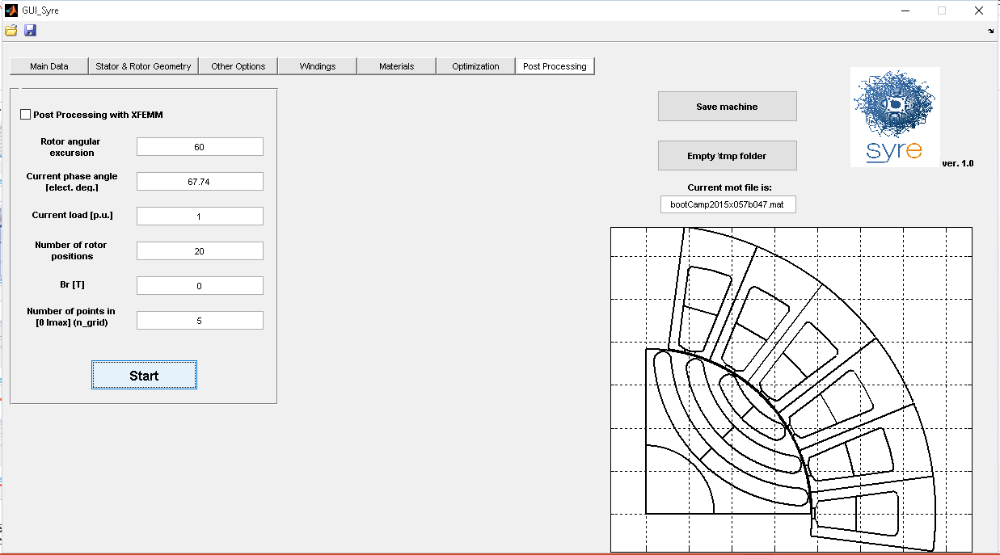
Run FEA
The Post Processing tab is for simulating a single machine with FEMM
The automatic settings dictated by srymDesign.m refer to rated current and uccrent phase angle, according to the not very precise (b,x) model:
1 p.u. current (1 times i0 [A])
phase angle (67.74°)
You can check i0 [A] in the “Other Options” tab: it is 8,12 A

Slide 19
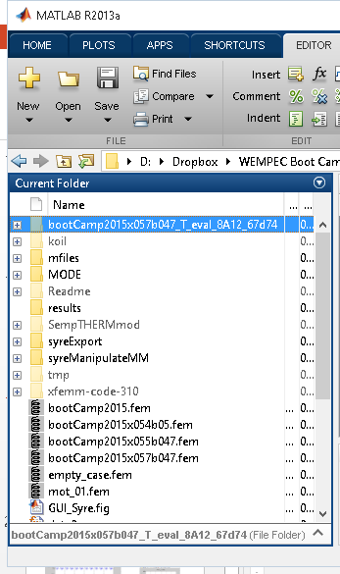
FEA Results Folder
A new folder is automatically created per each new simulation.
Such folder has the same name of the machine as root, plus additional information about current amplitude and phase angle of the simulation
In the example, the new directory name is “bootCamp2015x057b047_T_eval_8A12_67d74”, and it is in the syre root path
8A12_67d74 stands for 8.12 A (= i0 for this machine and this Joule loss loading) and current phase angle equal to 67,74 degrees

Slide 20
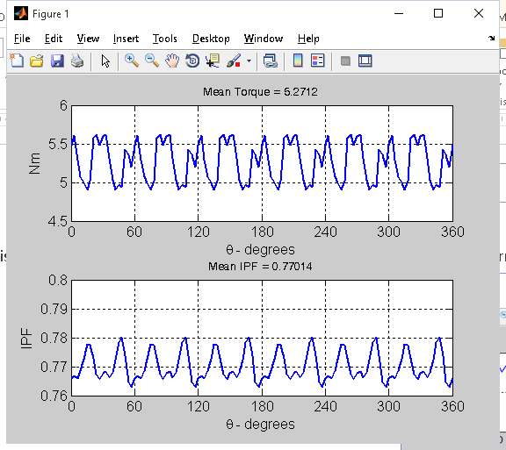
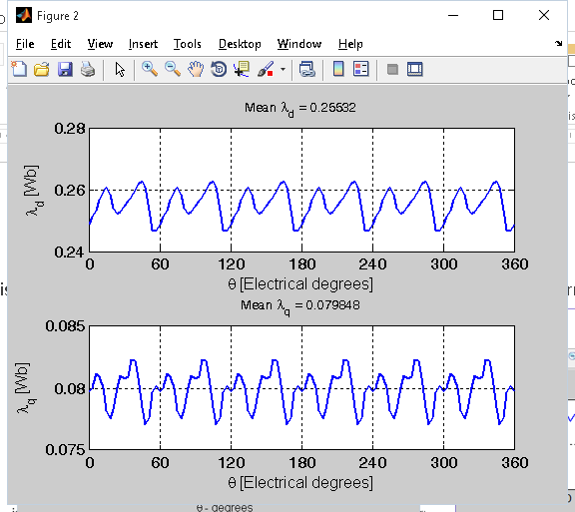
FEA evaluated Torque and PF
This two plots pop up just after the simulation. Figure 1 reports torque and internal PF waveforms
Fig1: Torque and PF
Fig2: flux linkage in DQ components

Slide 21
Comparison between Model and FEA
Expected torque from the (x,b) model was around 5.8 Nm, it is 5,5 Nm according to FEA
Expected PF was 0.82 plus, in FEA is 0,77
T(x,b) and PF(x,b) model
T and PF evaluated with FEMM

Slide 22
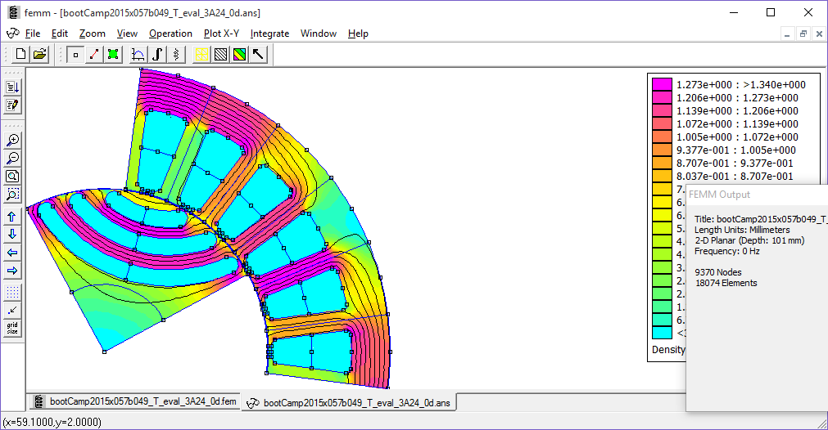
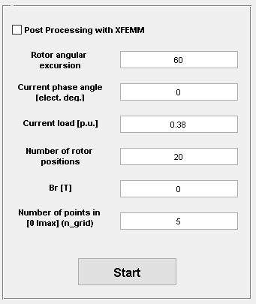
How to Verify the Correct Design of Rotor Carriers?
Another simulation can be launched, this time with current only in the magnetization direction (current phase angle = 0)
Amplitude of the current, in p.u., is suggested by the rated phase angle:
Current load [p.u.] = 1 * cos(67.74) = 0,38

Slide 23
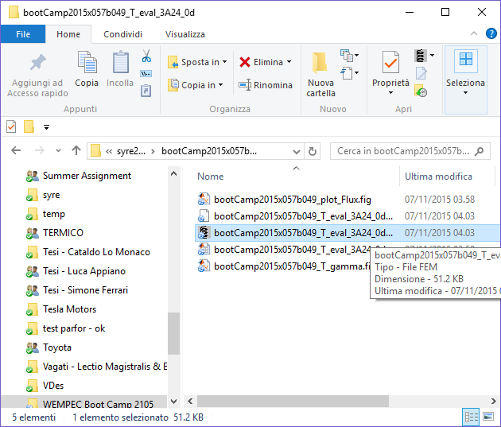
How to Visualize the Field Distribution
The results directory contains a copy of the femm model, with the phase currents appropriately set. It can be opened by clicking on the .fem file icon
This .fem file accounts for the last simulated position of just run multi-step static FEA
FEMM results file (.ans) was not memorized, so you will have to run the simulation of this fem file again manually

Slide 24
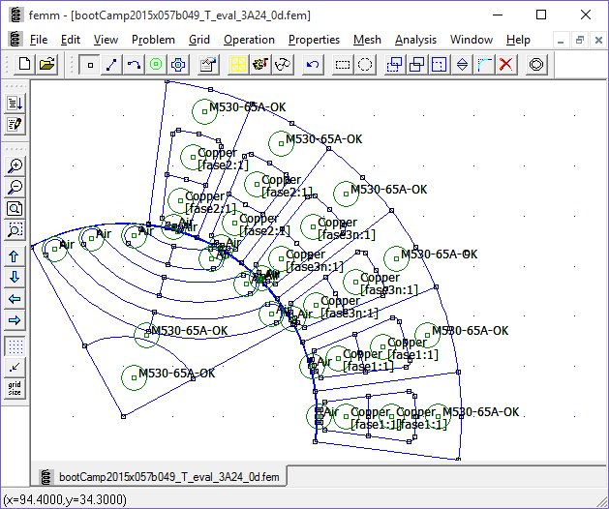
Run the simulation Manually
Use the buttons “Run analysis” and “View Results” in sequence
This is the .ans file. The rainbow button shows the colored density plot.

Slide 25
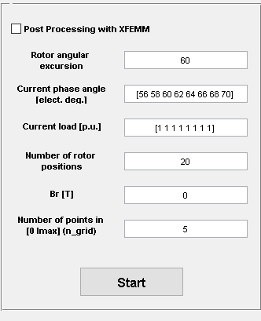
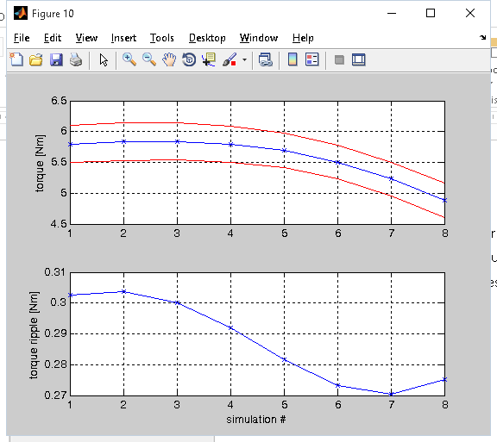
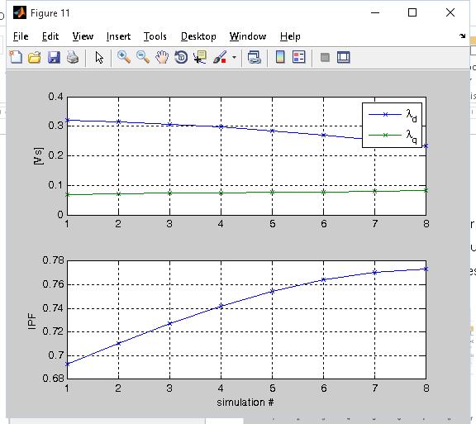
Find the actual MTPA angle
The post processing window permits to run multiple simulations at once
Current phase angle and current load must be vectors of the same dimension
Here we simulate different current angles around the one forecast by the (x,b) model (circa 68°)
Torque [Nm]
Max torque
Sim #
PF
Max PF
Max torque

Slide 26
FEA Results
Maximum torque angle is around 59° (instead of 68°) and max torque is 5.8 Nm
PF at max torque angle is 0,72, at max PF angle is 0,77
Torque [Nm]
Max torque
Sim #
PF
Max PF
Max torque

